Slide 1
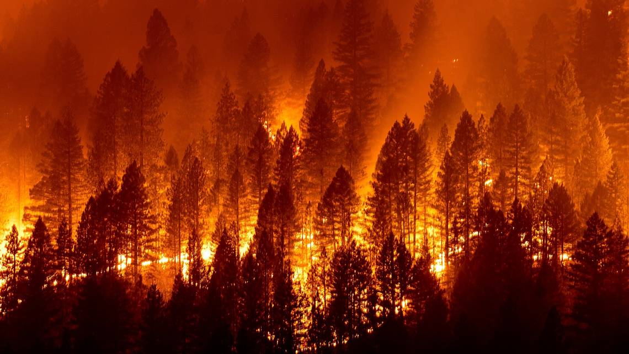
California Wildfires
Jinfang Li, Wendy Mudzinski, Stephen Tan, Rachel Tsuchiyama, Cassie Xu
https://github.com/stephen-tan/california-wildfires GitHub
Data.ipynb - Colaboratory (google.com) Colab

Slide 3
Why We Chose Wildfires
As we live in a state with high incidence of wildfires, we believe it is significant to use past wild fire data and precipitation and temperature data to predict what we may experience in the next fire season in order to spread out awareness to eliminate economic and personal injuries.

Slide 4
Description of Source Data
California Wildfires dataset from Cal Fire, downloaded from Kaggle.com
California Counties Boundares geoJSON file from the CNRA - California Natural Resources Agency
Drought Data from the CNRA
Statistical Weather and Climate Information from the NOAA - National Oceanic and Atmospheric Administration

Slide 5
Questions We Hope to Answer
When and where could the next California wildfire be?
How does temperature play a role in fire season?
Are there specific counties that are more prone to wildfires?
What's the main factor to cause a wildfire?

Slide 6
Description of the Data Exploration Phase
Conducted research on various national weather websites
Gained inspiration from Kaggle
Quite a bit of data cleansing was necessary including:
drop null rows
created new columns since there were no primary keys in any of the tables
these keys were created by concatenating county IDs with measurement year
combined weather (rainfall and temperature) data first, since both of those datasets were from the same source
combined weather data with kaggle wildfire dataset based on the keys created with measurement year and county IDs
created a new primary key for the wildfire data set, which has measurement year, county ID, and acres burned
this key needed to be added to a new column because some counties had multiple fires within the same year

Slide 7
Description of the Analysis Phase:
Initial analysis shows that with the dataset provided, and with varying inclement challenges, it’s difficult to provide an absolute prediction. To some extent fires are started accidentally and can spread quite quickly due to it’s surrounding environment. Based on past data, our model shows that we can predict at 88% accuracy.

Slide 8
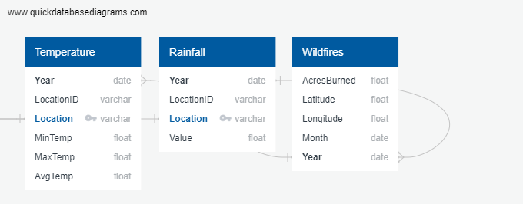
ERD Diagram on Relational DB

Slide 9
Data 9.9
https://www.kaggle.com/ananthu017/california-wildfire-incidents-20132020 California WildFires (2013-2020)
https://www.kaggle.com/jaeyoonpark/heatmap-animation-us-drought-map Heatmap animation - US Drought map
https://idahofirewise.org/fire-ecology-and-management/wildfire-ignition-behavior-and-effects/
https://www.ncdc.noaa.gov/cdo-web/datasets
https://www.ncdc.noaa.gov/data-access/satellite-data/satellite-data-access-sorted-satellite-instrument
https://ncar.ucar.edu/what-we-offer/data-services
https://www.ncdc.noaa.gov/climate-information/statistical-weather-and-climate-information
California Fire Map: Tracking wildfires near me, across SF Bay Area, Caldor Fire in Tahoe, Dixie Fire (sfchronicle.com)
California Natural Resources Agency Open Data
PRISM Climate Group, Oregon State U
https://www.ncdc.noaa.gov/cag/county/mapping/4/pcp/202003/1/mean

Slide 10
Answers Post-Analysis
When and where could the next California wildfire be?
How does temperature play a role in fire season?
Are there specific counties that are more prone to wildfires?
What's the main factor to cause a wildfire?

Slide 11
Dashboard Outline
Visualized temperature data
（Top 20 Bar Chart)
Filter by year (2013-2019)
California map (Avg Temp by Location
California map (Rainfall by Location
Visualized precipitation/humidity data
(Top 20 Bar Chart)
Filter by county
California map (Arcers Burned by Location)
Visualized arcers burned data
(Top 20 Bar Chart)

Slide 12
Database Outline
California WildFires (2013-2020) dataset
AcresBurned
AdminUnit
Counties
CountyIds
Extinguished
Latitude
Longitude
Started
Label (Prediction) = County
California_County_Boundaries.geojson
California rainfall dataset
Precipitation
Mean Temperature
Min Temperature
Max Temperature

Slide 13
Roles
Rachel - triangle
Wendy, Jinfang - X
Stephen - circle
Cassie - square

